Slide 1
Skin Cancer Detection Using Convolutional Neural Network

Slide 2
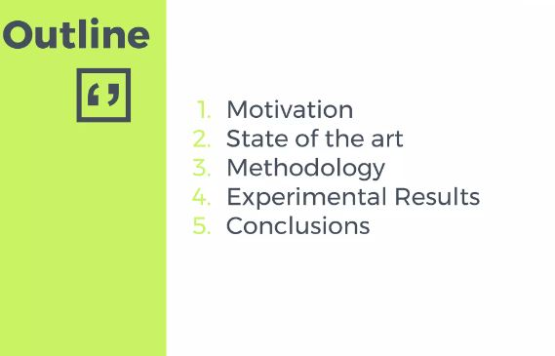
Introduction
Background
Scope
Challenges
Methodology
Experimental Results
Conclusion
Outline

Slide 3
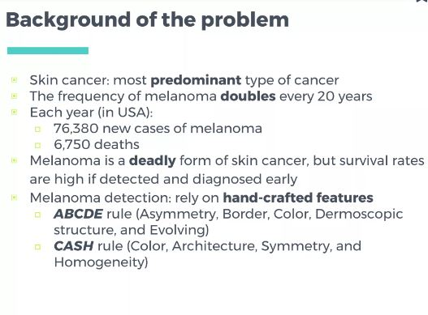
INTRODUCTION
This Project discusses the application of deep learning in diagnosing skin lesions from dermatoscopic images. The purpose of the project is to explore the potential use of a Deep Neural Network (DNN) for classifying skin lesions and investigate its clinical usefulness. The document mentions the use of the HAM10000 dataset, which consists of 10,015 dermatoscopic images of various classes of skin lesions. The classes used in the dataset are as follows: Actinic keratoses and intraepithelial carcinoma/Bowen's disease (akiec), basal cell carcinoma (bcc), benign keratosis-like lesions (bkl), dermatofibroma (df), melanoma (mel), melanocytic nevi (nv), and vascular lesions (vasc).

Slide 5
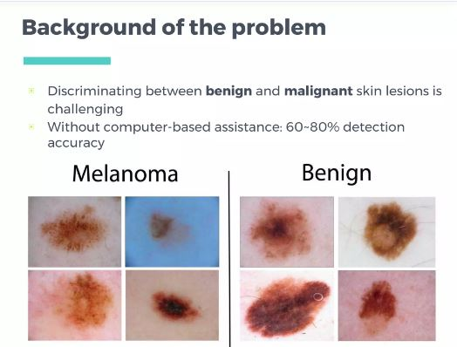

Slide 6
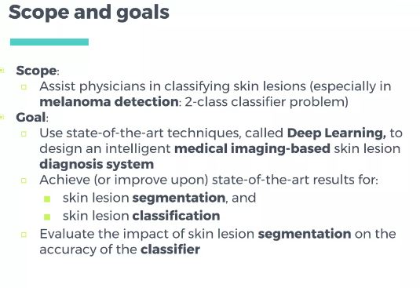

Slide 7
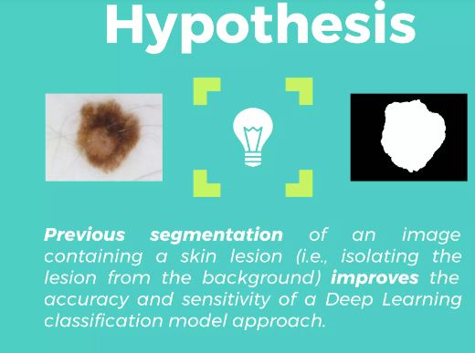

Slide 8
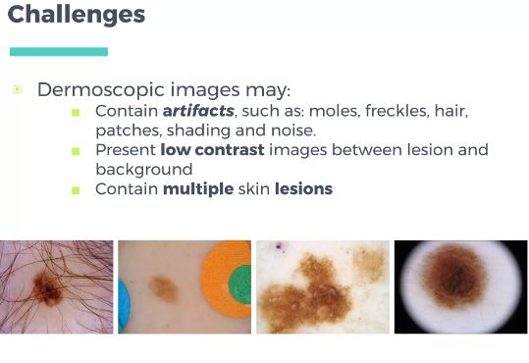

Slide 9
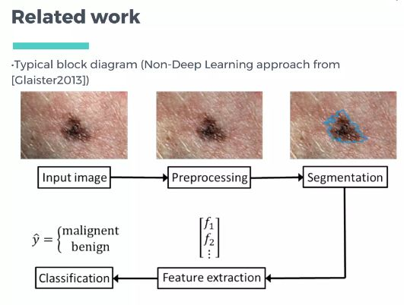

Slide 10
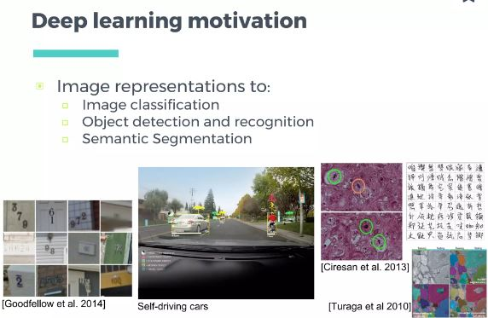

Slide 11
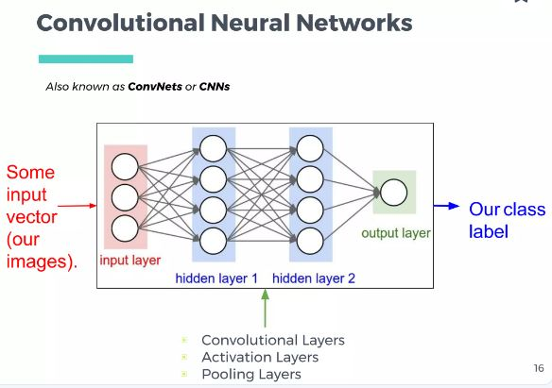

Slide 12


Slide 13
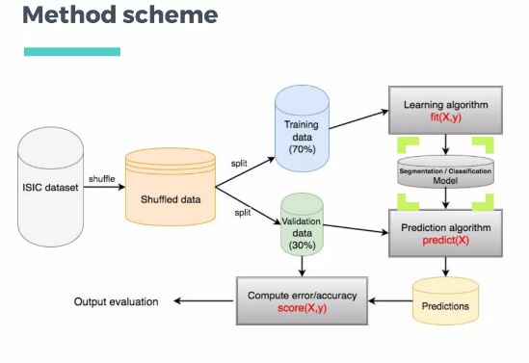

Slide 14
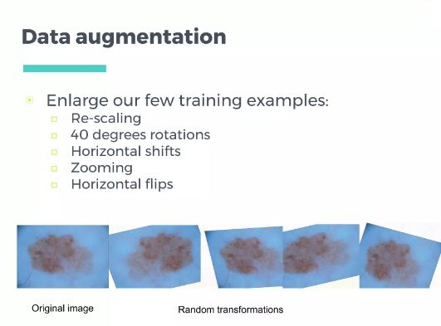

Slide 15
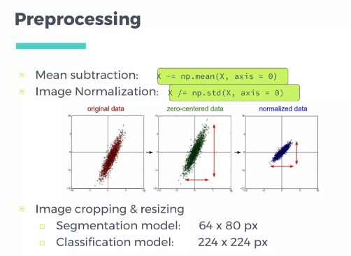

Slide 16
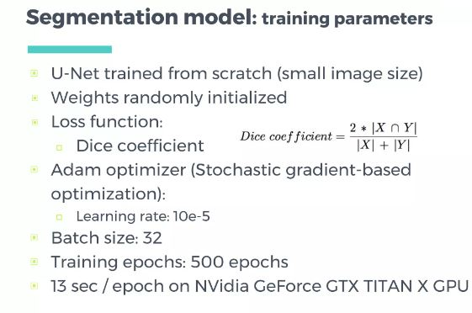

Slide 17
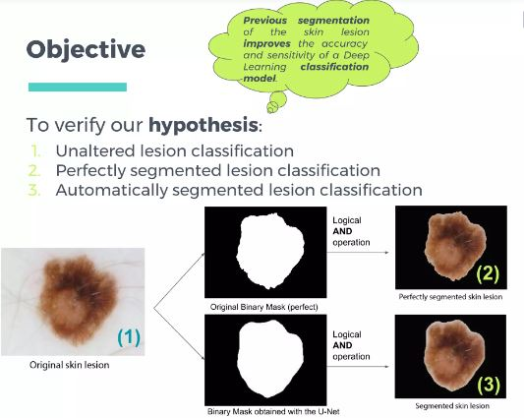

Slide 18


Slide 19
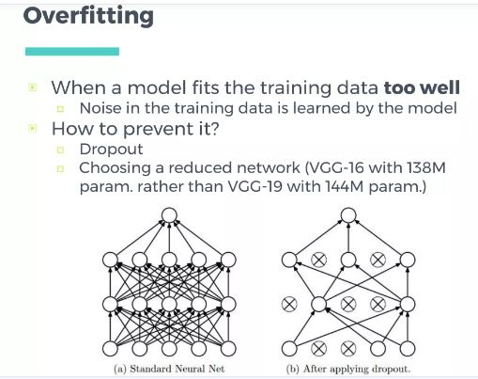

Slide 20
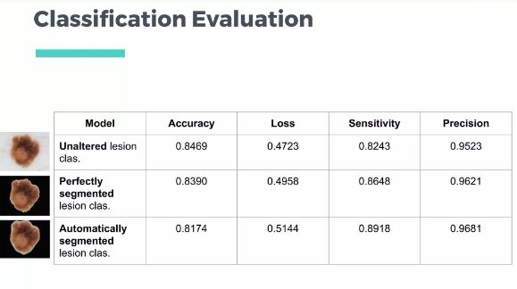

Slide 21
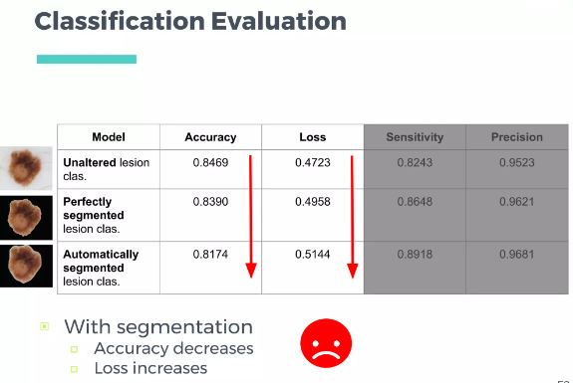

Slide 22
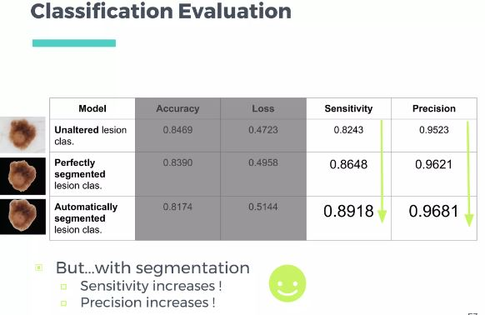

Slide 23
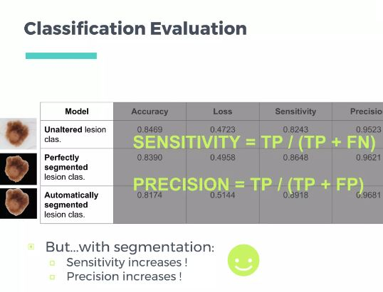

Slide 24
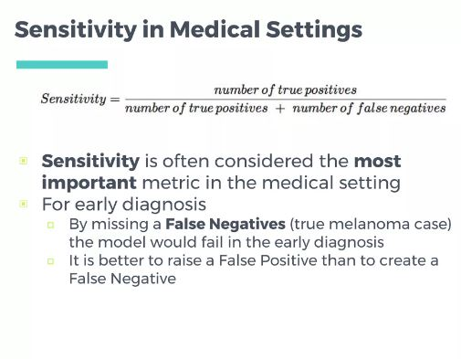

Slide 25
